Slide 1
Project Proposal
Anastasia Möller, Johannes Schadt, Sylviane Verschaeve, Tine Limberg
Notes:
Project Proposal

Slide 2
GOALS

Slide 3
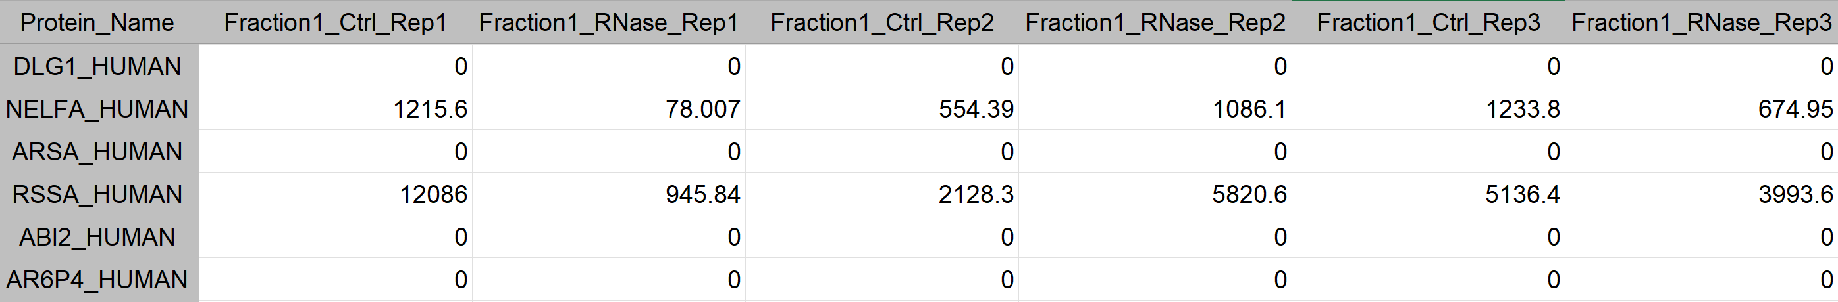
DATASET
Amount of NELFA_HUMAN
Fraction 1
Replicate 2
Control sample
150 columns
25 Fractions
3 Replicates – Control sample
3 Replicates – RNase sample
3680 rows
= proteins
Notes:
3680

Slide 4
DATASET -> genauer auf die Daten eingehen

Slide 5
TIMELINE
Milestone
1st
2nd
3rd
4th
5th
6th
7th
8th
9th
Notes:
Milestone

Slide 6
1st week
Notes:
1st

Slide 7
TIMELINE
Milestone
1st
2nd
3rd
4th
5th
6th
7th
8th
9th
Milestone
Notes:
Milestone

Slide 9
TIMELINE
Milestone
Milestone
1st
2nd
3rd
4th
5th
6th
7th
8th
9th
Milestone
Notes:
Milestone

Slide 11
TIMELINE
Milestone
Milestone
1st
2nd
3rd
4th
5th
6th
7th
8th
9th
Milestone
Milestone
Notes:
Milestone

Slide 13
TIMELINE
Milestone
Milestone
Milestone
1st
2nd
3rd
4th
5th
6th
7th
8th
9th
Milestone
Milestone
Notes:
Milestone

Slide 15
TIMELINE
Milestone
Milestone
Milestone
1st
2nd
3rd
4th
5th
6th
7th
8th
9th
Milestone
Milestone
Milestone
Notes:
Milestone

Slide 17
TIMELINE
Milestone
Milestone
Milestone
Milestone
1st
2nd
3rd
4th
5th
6th
7th
8th
9th
Milestone
Milestone
Milestone
Notes:
Milestone

Slide 19
TIMELINE
Milestone
Milestone
Milestone
Milestone
1st
2nd
3rd
4th
5th
6th
7th
8th
9th
Milestone
Milestone
Milestone
Milestone
Notes:
Milestone

Slide 21
DATASET -> genauer auf die Daten eingehen

Slide 22
DATASET -> genauer auf die Daten eingehen

Slide 23
DATASET -> genauer auf die Daten eingehen

Slide 25
DATASET -> genauer auf die Daten eingehen

